Slide 1
Automated Development for Cross-Platform Internet of Things
Develop a secure, certified hardware prototype in 15 minutes
Clarke Stevens Shaw Communications clarke.stevens@sjrb.ca

Slide 2
What is the Open Connectivity Foundation?
Standards body for interoperable IoT
Strong security built in from the start
Works interoperably with existing ecosystems
Three pillar alignment
International specification
Open source implementation
Automated certification tool and international authorized test labs
Flexible, RESTful, data-model-based architecture

Slide 3
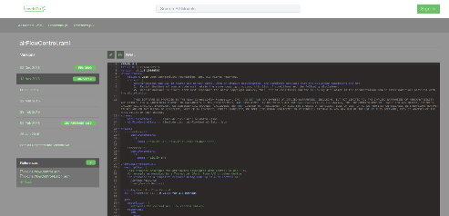
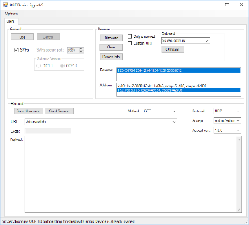
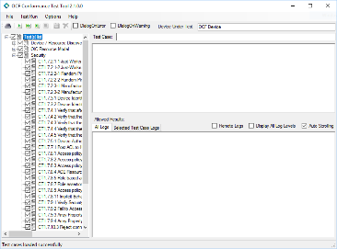
Complete suite of development tools
Online tool for crowd-sourcing data models and building ecosystem interoperability
Data models drive everything
Automated tool chain creates
Server source code
Introspection file
Automated test case file
Secure onboarding file
Client tool user interface
Several test and development tools

Slide 4

oneIoTa (oneiota.org)
oneIoTa is an IDE and process management tool for the resource data models at the center of OCF.
OCF atomic resource models are entered in the editor windows in oneIoTa
More complex resources can be composed of atomic resources
Completed resources are submitted to an approval process for OCF (or partner organizations
Other organizations use the same approval process in oneIoTa
Mappings between OCF and other ecosystems are also entered in oneIoTa
Resource models are used to build specifications, devices, source code, GUIs, PICS files and bridges

Slide 5
oneIoTa is the source of all resources you will need
Go to http://www.oneiota.org
Search for any resources you will need
Use these descriptions when defining your device description file
All devices consist of a list of resources
All tools will consider oneIoTa as the authoritative source of resources

Slide 6
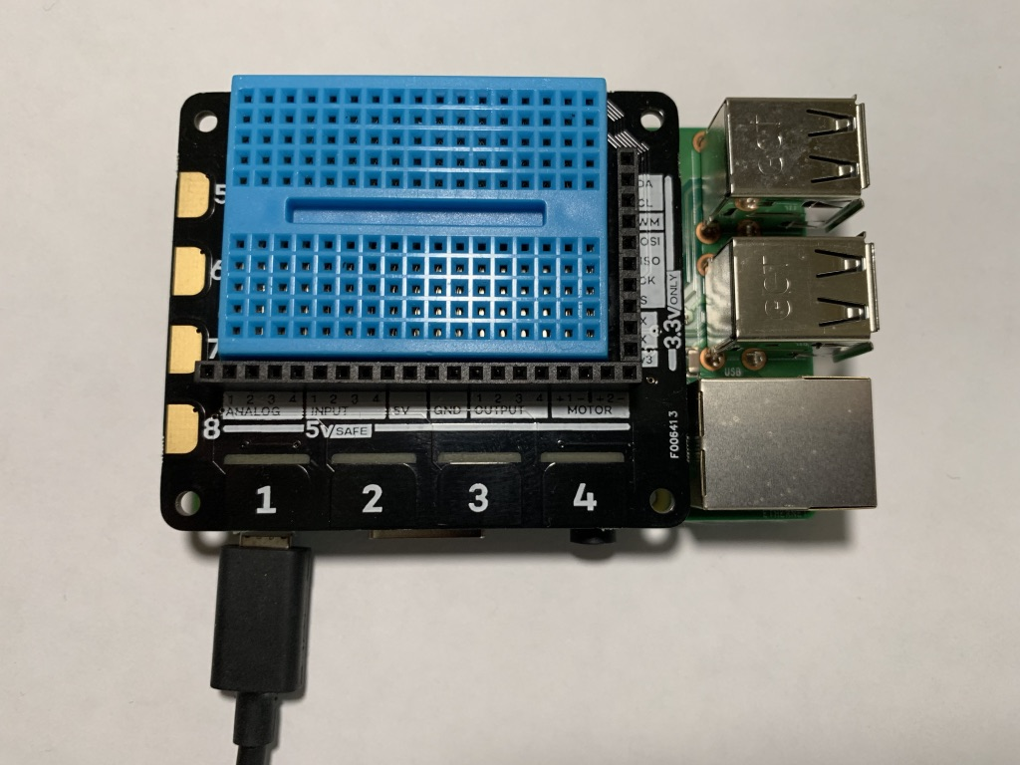
Set up the Hardware (Explorer Hat)
Install the ExplorerHat board on the GPIO header on the Raspberry Pi board
Insert the microSD card
Connect the network (automatic)
Plug in the power
Connect keyboard and monitor (or SSH)

Slide 7
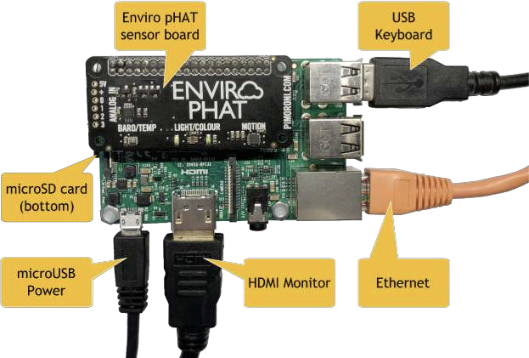
Set up the Hardware (Automation pHat)
Install the AutomationPhat board on the GPIO header on the Raspberry Pi board
Connect a resistor and LED from 5V to output 1(+5-LED-resistor-output 1)
Connect a switch between 5V and input 1 (+5-switch-input 1)
Insert the microSD card
Connect the network
Plug in the power
Connect keyboard and monitor (or SSH)

Slide 8
Set up the SD card for Raspberry Pi
Install PiBakery on Windows or MacOS (https://www.pibakery.org)
Run PiBakery and import this file (file reference)
Enter the Wi-Fi credentials and a desired hostname in the provided fields
Choose whether you want the desktop or the console version
Insert an SD/SD Micro card, click “Write” to create the Raspbian card.
Choose if you want to install the full or lite version of Raspian
Wait for the write to finish, then eject the SD card from your computer

Slide 9
Boot and Connect to the Raspberry Pi
Get a terminal view of the Raspberry Pi
Connect a monitor, keyboard and (optional) mouse to the Raspberry Pi, or
Connect from your computer using SSH
You can ping the Raspberry Pi (ping <your host name>.local) to verify that the Raspberry Pi is available
If it is taking a long time, try “sudo killall –HUP mDNSResponder” on MacOS
MacOS
Use the terminal program and “New Remote Connection
Windows
Use Putty on (or similar)
SSH to the Raspberry Pi using “ssh://pi@<your host name>.local”
Default login: user: pi, password: raspberry

Slide 10
Alternative Set up of the SD card for Raspberry Pi (hard way)
Go through the NOOBS process to install the headless Raspian Stretch Lite located here: https://www.raspberrypi.org/downloads/raspbian/
Enable ssh: copy an empty file called “ssh” (no extension) to the SD card root directory (https://github.com/openconnectivity/Sample-Raspberry-Pi-Code/blob/master/ssh)
Optionally set up a Wi-Fi connection by copying wpa_supplicant.conf to the SD card root directory and edit for your Wi-Fi (https://github.com/openconnectivity/Sample-Raspberry-Pi-Code/blob/master/wpa_supplicant.conf)
It is convenient to use your computer as the terminal for the Raspberry Pi. In order to do this, you will need to know the IP address of the Raspberry Pi. The simplest was is to connect a monitor to the HDMI port. The IP address will print out near the end of the boot process.
Boot the Raspbery Pi by inserting the SD card and powering the board on. Write the IP address down so you’ll remember it.
Get a terminal view using a monitor and keyboard or ssh. (Putty on Windows, or the Go menu on Mac will give you an SSH connection)
Default login: user: pi, password: raspberry

Slide 11
Set up the development environment (Network)
This method will work you are on a network
Install the development environment
Install all of this from the home directory: cd ~
IoTivity-lite development: curl https://openconnectivity.github.io/IOTivity-Lite-setup/install.sh | bash
Project scripts: curl https://openconnectivity.github.io/Project-Scripts/install.sh | bash
Raspberry Pi examples (answer “y” to all the prompts): curl https://openconnectivity.github.io/Sample-Raspberry-Pi-Code/pi-boards/install.sh | bash
Make sure the PATH is set: reboot or source ~/.bashrc

Slide 12
Set up the development environment (USB Stick)
This method works if you have a USB stick set up by OCF
Mount the USB stick on the Raspberry Pi
Create a mount point: sudo mkdir /mnt/myusb (you can name it something else)
Mount the drive: sudo mount –o uid=pi,gid=pi /dev/sda1 /mnt/myusb
Install the development environment
Install all of this from the home directory: cd ~
IoTivity-lite development: cat /mnt/myusb/IOTivity-Lite-setup/install.sh | bash
Project scripts: cat /mnt/myusb/Project-Scripts/install.sh | bash
Raspberry Pi examples (answer “y” to all the prompts): cat /mnt/myusb/Sample-Raspberry-Pi-Code/pi-boards/install.sh | bash
Unmount the USB stick: umount /mnt/myusb
Make sure the PATH is set: reboot or source ~/.bashrc

Slide 13
Let’s build a device (page 1)
Create a directory for development (this can be anywhere, but we’ll use the following):
cd ~
mkdir workspace
cd workspace
Create an OCF project (can be named anything, but we’ll use the following):
create_project.sh myexample
cd myexample
We’ll use a pre-built sample to start:
cp ~/Sample-Raspberry-Pi-Code/IoTivity-lite/explorer-hat-pro/setup.sh ./
./setup

Slide 14
Let’s build a device (page 2)
Automatically generate the code, introspection file and security files:
gen.sh
Build the project executiable:
build.sh
Set the security to “ready for owner transfer method” (RFOTM):
reset.sh
Run the server code on the Raspberry Pi:
run.sh
You have successfully build an OCF device and it is ready to onboard!

Slide 15
Onboard and control the server with OTGC
Install OTGC on an Android device (make sure you’re on the right LAN):
(download and run the APK or get it from the OCF USB stick)
Launch the OTGC application
Click the discover button to search for OCF devices on the LAN
Arrow in circle icon
Onboard the discovered server
“+” icon associated with the server device
Get the UI to control the Raspberry Pi server from the Android OTGC
Gear icon
Use the UI to turn on and off any of the lights on the ExplorerHat board
Use the AI to turn on “observe” on any of the switches, then watch the terminal as you press the button on the ExplorerHat board
You have successfully onboarded and controlled your OCF Device!

Slide 16
What we did
Started with an OCF configuration file:
edit_config.sh
Created an OCF input file:
edit_input.sh
Created the server code, introspection file and sercurity files:
edit_code.sh
ls
Used OTGC to discover, onboard and control the device
OTGC

Slide 17
Let’s try a more complicated example (page 1)
Create a new OCF project (can be named anything, but we’ll use the following):
cd ~/workspace
create_project.sh automationphatlite
cd automationphatlite
We’ll use another pre-built sample:
cp ~/Sample-Raspberry-Pi-Code/IoTivity-lite/automation-phat-example/setup.sh ./
./setup
This time, setup will also copy over hardware interface files
Explore what is now in the bin directory: ls bin

Slide 18
Let’s build a more complicated device (page 2)
The same as before
Automatically generate the code, introspection file and security files:
gen.sh
Build the project executiable:
build.sh
Set the security to “ready for owner transfer method” (RFOTM):
reset.sh
Run the server code on the Raspberry Pi:
run.sh
Run OTGC to
Control the hardware light on the Raspberry Pi
Turn on observe and the switch will change on the client when you switch it in hardware

Slide 19
Here’s how you can do it on your own (page 1)
Create a new OCF project (can be named anything, but we’ll use the following):
cd ~/workspace
create_project.sh mytestproject
cd mytestproject
Edit the configuration file for your specific device:
edit_config.sh
Automatically generate the code, introspection file and security files (this usually only needs to be done once unless the config file is changed):
gen.sh

Slide 20
Here’s how you can do it on your own (page 2)
Use the same development loop as before, but edit the code as necessary:
Edit the code:
edit_code.sh
Build the project executiable:
build.sh
Set the security to “ready for owner transfer method” (RFOTM):
reset.sh
Run the server code on the Raspberry Pi:
run.sh
Run OTGC and control the server on the Raspberry Pi

Slide 21
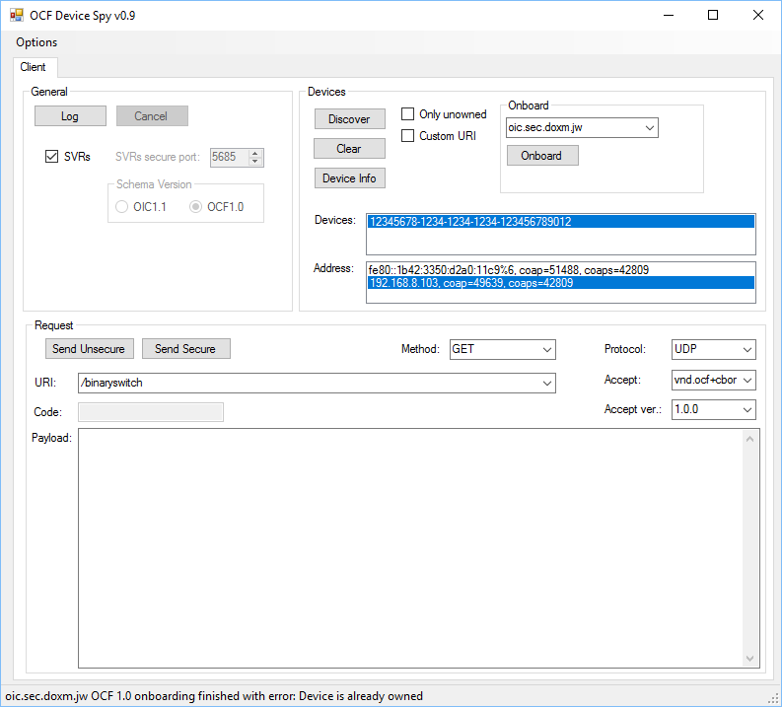
Testing with Device Spy (as an alternative to OTGC)
Device Spy is a lower level client that allows you to construct the actual payloads that are sent. It is only available on Windows.
Discover the device by clicking the [Discover] button
Onboard the device by clicking SVRs, selecting an address and clicking the [Onboard] button
Inspect the resource payload by setting the resource URI, selecting the GET method and clicking the [Send Secure] button
Change the value of the resource (e.g. false to true) by selecting the POST message and clicking the [Send Secure] button
The state of the light should change accordingly

Slide 22
Other useful information

Slide 23
Simple device description input file
[
{
"path" : "/binaryswitch",
"rt" : [ "oic.r.switch.binary" ],
"if" : ["oic.if.a", "oic.if.baseline" ],
"remove_properties" : [ "range", "step" , "id", "precision" ]
},
{
"path" : "/oic/p",
"rt" : [ "oic.wk.p" ],
"if" : ["oic.if.baseline", "oic.if.r" ],
"remove_properties" : [ "n", "range", "value", "step", "precision", "vid" ]
}
]

Slide 24
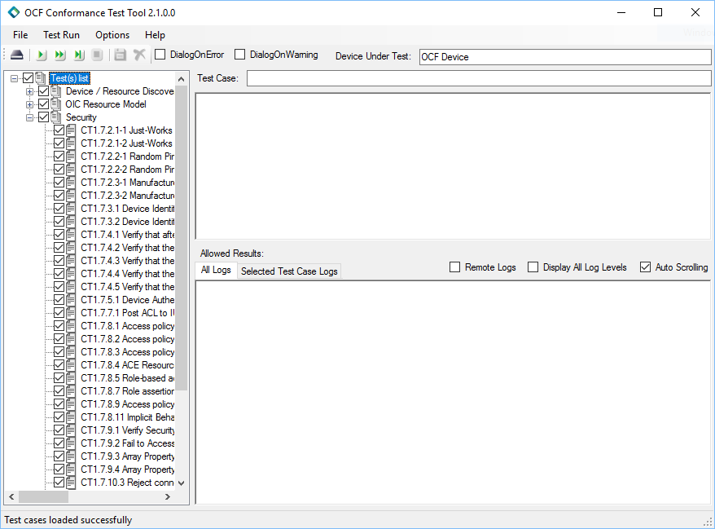
Run the Certification Test Tool
The Certification Test Tool is and automated test too that devices must pass to get OCF certification
Run the CTT
Select the PICS file generated by gen.sh
Select the discovered device and the interface to use
Click the play button to start the tests
Go get coffee
But don’t take too long because you will need to change the onboarding state to RFOTM a few times
Pass the CTT and work with a certified lab to get official certification.
Available to OCF members

Slide 25
What to do next
Define your own input file
Run the tooling!
Build it… and see if it works
Change the code, to what you want it to do

Slide 26
What else?
The DeviceBuilder can be modified for any programming language using templates
The OTGC will be available on Android, iOS, Linux and Windows soon
The OTGC will be available as open source, so you can use a product that is already OCF certified as the basis for your own client tool on multiple operating systems
There is a node.js version of IoTivity available
IoT boards from other companies are supported with these tools
Samsung EagleEye
Linux emulator using Glade for UI
More to be added soon

Slide 27
Acknowledgments and references
All of this has been developed by the dedicated volunteers and contractors of Open Connectivity Foundation (http://openconnectivity.org)
Wouter van der Beek of Cisco is the Chair of the OCF Technical Steering, is responsible for key architectural design and personally developed the DeviceBuilder and the key scripts in this presentation.
Dekra created the OTGC tool under contract to OCF. The tool will be available as open source on Android, iOS, Linux and Windows in the Fall.
Comarch created the CTT and DeviceSpy under contract to OCF. These tools are available to OCF members.
For complete summarized instructions, look here: https://github.com/openconnectivity/Project-Scripts/blob/master/One%20Page%20Complete%20Setup%20Instructions.md

Slide 29
Connect to the Raspberry Pi
MacOS
Start terminal: (command-K from finder) or “terminal” from Spotlight
Enter SSH address: ssh://pi@<hostname>.local
Refresh DNS: sudo killall –HUP mDNSResponder
Windows
Start terminal: run putty
Get the IP address from someone with linux or a Mac
Enter SSH address: ssh://pi@<IP address>
Refresh DNS: ipconfig /flushdns
Linux
Start terminal: usually in sidebar, but can type terminal in search applications
Enter SSH command: ssh pi@<hostname>.local
Refresh DNS: sudo /etc/init.d/dns-clean restart
Default login: user: pi, password: raspberry

